Slide 1
Dynamic Memory Management
Tools for creating dynamic data structures

Slide 2
Practical Data Structures
We need data structures that can grow and shrink during execution.
Implementing d ^{y} n a ^{m} i _{c} data structures needs two important aspects:
Dynamic memory allocations
Self-referential structures

Slide 3
Dynamic Memory Manipulations
Dynamic Memory Allocation: malloc()
/* header file stdlib.h declares the function */
#include <stdlib.h>
void * malloc(size_t size);
size_t has been type-defined to unsigned int.
size is the number of bytes required in the allocation.
malloc() returns a pointer to a block of memory of size bytes.
The function call returns NULL when the allocation fails.
From the C reference manual:

Slide 4
Get some Bytes Using malloc()
1
2
3
4
5
6
7
8
9
10
11
12
13
14
15
16
17
18
19
#include <stdio.h>
#include <stdlib.h>
int main(void) {
int amount;
void *ptr;
printf("How many bytes? ");
scanf("%d", &amount);
ptr = malloc(amount);
if (ptr != NULL)
printf("Address: %p\n", ptr);
else
printf("Failed to allocate memory!\n");
return 0;
}
Program dyn_1.c
/* Declare variables */
/* Ask for a size from the user */
/* Call malloc() to do the magic */
/* Check if it is ok */
How many bytes? 1000000000↵
Address: fa265fd0
Get ~1GB of memory!

Slide 5
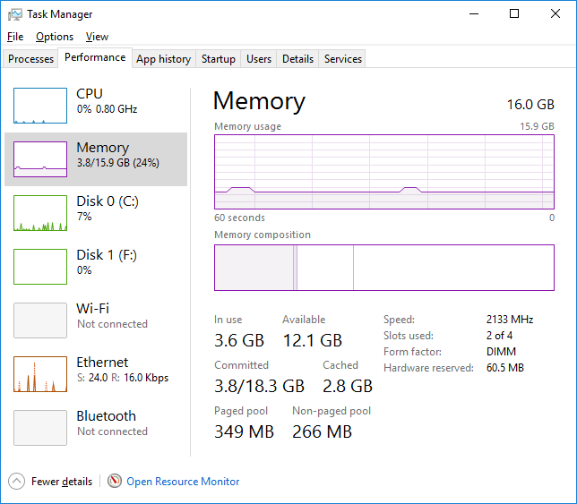
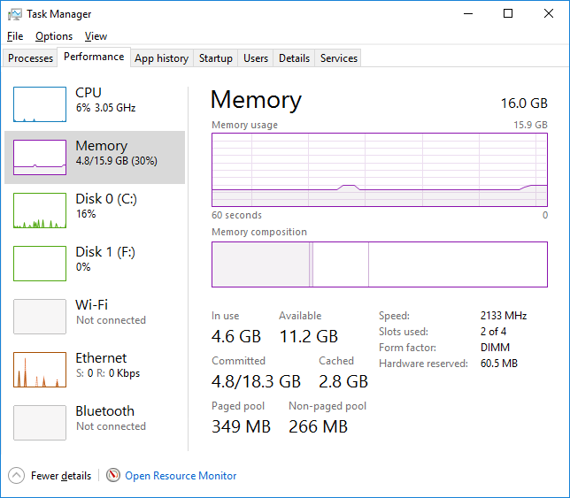
Memory Usage at a Glance!

Slide 6
Get a few Bytes Using malloc()
Program dyn_2.c
1
2
3
4
5
6
7
8
9
10
11
12
13
14
15
#include <stdio.h>
#include <stdlib.h>
int main(void) {
int *ptr;
ptr = (int *)malloc( sizeof(int) );
if (ptr != NULL) {
*ptr = 97;
printf("The int stored at %p is %d.\n", ptr, *ptr);
}
return 0;
}
/* Declare an integer pointer variable */
/* Call malloc() to get 4 bytes */
/* Store an integer into the memory pointed by ptr */
The int stored at fa265fd0 is 97.
Get a storage for an integer!

Slide 7
Memory allocation (using malloc())
int *ptr;
ptr = (int *)malloc(sizeof(int));
*ptr = 97;
Pictorial View
ptr
?
Memory View
 |  |  |  |  |  | ?
… | 100 | 101 | 102 | 103 | 104 | 105 | 106 | 107 | 108 | 109 | 110 | …
… | 800 | 801 | 802 | 803 | 804 | 805 | 806 | 807 | 808 | 809 | 810 | …
ptr, a pointer variable, is automatically allocated a memory space for storing an address.

Slide 8
Memory allocation (using malloc())
int *ptr;
ptr = (int *)malloc(sizeof(int));
*ptr = 97;
Pictorial View
ptr
?
?
Memory View
 |  |  |  |  |  | ?
… | 100 | 101 | 102 | 103 | 104 | 105 | 106 | 107 | 108 | 109 | 110 | …
 |  | ?
… | 800 | 801 | 802 | 803 | 804 | 805 | 806 | 807 | 808 | 809 | 810 | …
malloc() reserves a memory space that is big enough to store a value of type int.

Slide 9
Memory allocation (using malloc())
int *ptr;
ptr = (int *)malloc(sizeof(int));
*ptr = 97;
Pictorial View
ptr
?
Memory View
 |  |  |  |  |  | 800
… | 100 | 101 | 102 | 103 | 104 | 105 | 106 | 107 | 108 | 109 | 110 | …
 |  | ?
… | 800 | 801 | 802 | 803 | 804 | 805 | 806 | 807 | 808 | 809 | 810 | …
malloc() returns the address of the reserved space and the address is assigned to ptr.

Slide 10
Memory allocation (using malloc())
int *ptr;
ptr = (int *)malloc(sizeof(int));
*ptr = 97;
Pictorial View
ptr
97
Memory View
 |  |  |  |  |  | 800
… | 100 | 101 | 102 | 103 | 104 | 105 | 106 | 107 | 108 | 109 | 110 | …
 |  | 97
… | 800 | 801 | 802 | 803 | 804 | 805 | 806 | 807 | 808 | 809 | 810 | …
Store 97 in the allocated space pointed to by ptr.
The allocated space is like a "variable of type int" except that it has no name.

Slide 11
Losing Allocated Space
Bye Bye!
int *ptr;
ptr = (int *)malloc(sizeof(int));
*ptr = 10;
ptr = (int *)malloc(sizeof(int));
ptr
10
?
The allocated space has no corresponding name in the program.
If you lose the memory address of an allocated space, you lose the data stored in that space and you lose the space.
Allocated space will stay reserved until it is explicitly released or until the program terminates.

Slide 12
Dynamic Memory Manipulations
Dynamic Memory De-Allocation: free()
/* header file stdlib.h declares the function */
#include <stdlib.h>
void free(void * ptr);
void * is a generic pointer type, i.e. pointer of ANY type.
ptr is a pointer to a block of memory previously allocated by malloc().
It releases the block of memory pointed to by ptr.
From the C reference manual:

Slide 13
Complete: malloc(), then free()
Program dyn_3.c
1
2
3
4
5
6
7
8
9
10
11
12
13
14
15
16
17
18
#include <stdio.h>
#include <stdlib.h>
int main(void) {
int * ptr;
ptr = (int *)malloc(sizeof(int));
if (ptr != NULL)
{
*ptr = 97;
printf("The int stored at %p is %d.\n", ptr, *ptr);
}
free(ptr);
ptr = NULL;
return 0;
}
/* Declare an integer pointer variable, points to nothing initially */
/* Call malloc() to get 4 bytes */
/* Store an integer into the memory pointed by ptr */
/* RELEASE the memory pointed by ptr, integer 97 is LOST */
/* SET ptr to NULL after free() as a good practice */

Slide 14
int *iptr1, *iptr2;
/* Allocate a space (#1) to store an integer.
Initial value is undefined. */
iptr1 = (int *)malloc(sizeof(int));
/* Allocate another space (#2) to store an integer
and initialize its value to 10. */
iptr2 = (int *)malloc(sizeof(int));
*iptr2 = 10;
/* Free the space pointed to by iptr1 */
free(iptr1); /* Release space #1 */
/* Make iptr1 and iptr2 point to
the same location (space #2) */
iptr1 = iptr2;
/* It is possible to free a space through other pointer.
Free the space pointed to by iptr1. */
free(iptr1); /* Release space #2 */
iptr1
?
iptr2
10
?
iptr1
?
iptr1
10
iptr2
10
iptr2
iptr1
?
iptr2
10

Slide 15
Common Mistakes in Using free()
(Runtime error) Cannot free a piece of memory that is not allocated using malloc().
int x;
int *ptr;
ptr = &x;
free(ptr);
Runtime error if ptr is not NULL.
Cannot free a space that is not allocated using malloc().
int *ptr;
free(ptr);
free() won't do anything if the pointer is NULL.
int *ptr = NULL;
free(ptr);

Slide 16
Common Mistakes in Using free()
int *ptr;
ptr = (int *)malloc(sizeof(int));
free(ptr);
…
*ptr = 10;
Dangerous to use freed space because the freed space could have been re-allocated to someone elsewhere.
int *ptr;
ptr = (int *)malloc(sizeof(int));
free(ptr);
free(ptr);
(Runtime error) Cannot free a freed space.

Slide 17
Dynamic VS Automatic
Dynamic memory:
manual allocation and de-allocation
memory size determined at run-time
after de-allocation, the block of memory is made available for further dynamic allocation
IMPORTANT: manually free memory blocks after use! Why?
Automatic variable:
automatic creation and destruction
memory size determined at compile-time

Slide 18
Dynamic Memory for Structures
1
2
3
4
5
6
7
8
9
10
11
12
13
14
15
16
17
18
19
20
21
22
23
24
#include <stdio.h>
#include <stdlib.h>
typedef struct {
double x, y;
} Coordinates;
int main(void) {
Coordinates point1 = {3.4, -5.9}, *ptr;
ptr = &point1;
ptr->x = 3.458;
ptr->y = -5.967;
ptr = (Coordinates *)malloc( sizeof(Coordinates) );
if ( ptr == NULL )
return 0;
ptr->x = 47.57;
ptr->y = 23.45;
free(ptr);
return 0;
}
/* Define a structure type */
/* Declare a structure point1 and a pointer ptr */
/* Modify point1 via ptr */
/* Create ANOTHER structure dynamically and manipulate it */
/* Free it after use */

Slide 19
Self-Referential Structures
A self-referential structure is a structure that contains a pointer member that points to a structure of the same structure type.
Example:
struct node {
int data;
struct node *nextptr;
};

Slide 20
Self-Referential Structures
The member nextptr can be used as a link to "tie" a struct node structure to another structure of the same type.
struct node {
int data;
struct node *nextptr;
};
15
30
…
n1
n2

Slide 21
Self-Referential Structures
1
2
3
4
5
6
7
8
9
10
11
12
13
14
15
16
17
18
#include <stdio.h>
struct node {
int data;
struct node *nextptr;
};
int main(void) {
struct node n1, n2;
n1.data = 15;
n1.nextptr = &n2;
n2.data = 30;
n2.nextptr = NULL;
return 0;
}
NULL is used when the pointer points to nothing.
Self-referential structures can form useful data structures like lists, queues, …

Slide 22
Self-Referential Structures
Dynamic memory allocation can be used such that a data structure contains varying number of nodes as required.
A node can be created dynamically when needed.
struct node *ptr;
……
ptr = (struct node *)malloc(sizeof(struct node));

Slide 23
1
2
3
4
5
6
7
8
9
10
11
12
13
14
15
16
17
18
19
20
21
22
23
#include <stdio.h>
#include <stdlib.h>
struct node {
int data;
struct node *nextptr;
};
int main(void) {
struct node n1, *ptr;
n1.data = 15;
n1.nextptr = NULL;
ptr = (struct node *)malloc(sizeof(struct node));
ptr->data = 30;
ptr->nextptr = NULL;
n1.nextptr = ptr;
……
free(ptr);
return 0;
}

Slide 24
Summary
Dynamic memory allocation
Dynamic memory de-allocation
Dynamic memory VS Automatic variable
Dynamic memory for creating structure
Self-referential structure
Optional/ advanced topic:
Dynamic memory for creating 1D and 2D arrays

Slide 25
Reading Assignment
C: How to Program, 8th ed, Deitel and Deitel
Chapter 7 C Pointers
Section 7.7: sizeof Operator
Sections 7.8 – 7.9: Pointer Arithmetic & Arrays
Chapter 12 C Data Structures
Section 12.2: Self-Referential Structures
Section 12.3: Dynamic Memory Allocation

Slide 26
Dynamically Allocate an 1-D Array
(Optional)
1
2
3
4
5
6
7
8
9
10
11
12
13
14
15
16
17
18
19
20
#include <stdio.h>
#include <stdlib.h>
int main(void) {
int i, num, *ptr, *baseptr;
printf("How many integers? ");
scanf("%d", &num);
baseptr = (int *)malloc( sizeof(int) * num );
if ( baseptr == NULL )
return 0;
printf("Enter %d integers: ", num);
ptr = baseptr;
for (i = 0; i < num; i++) {
scanf("%d", ptr);
ptr++;
}
……
Program dyn_4.c
/* Allocate memory for a few integers */
/* Read integers into the memory block */
/* pointer arithmetic: memory address calculation */

Slide 27
Dynamically Allocate an 1-D Array
(Optional)
Program dyn_4.c (continue)
20
21
22
23
24
25
26
27
28
29
30
31
32
……
printf("The numbers are: ");
ptr = baseptr;
for (i = 0; i < num; i++) {
printf("%d ", *ptr);
ptr++;
}
printf("\n");
free(baseptr);
return 0;
}
/* Print the integers in the memory block */
/* Release the memory block pointed by the Base Pointer */
How many integers? 10↵
Enter 10 integers: 9 7 45 3 222 11 66 99 77 -199↵
The numbers are: 9 7 45 3 222 11 66 99 77 -199

Slide 28
Dynamically Allocate an 1-D Array
(Optional)
baseptr (the Base Pointer) always keeps the Base Address of the memory block allocated by malloc().
We must free the WHOLE memory block at once, with this Base Address.
ptr (the Working Pointer) “moves” in the memory block, pointing to different locations storing integers.
Alternative technique: use baseptr[i] or *(baseptr + i) instead of ptr.

Slide 29
1
2
3
4
5
6
7
8
9
10
11
12
13
14
15
16
17
18
19
20
21
22
23
24
25
#include <stdio.h>
#include <stdlib.h>
int main(void) {
int i, num, *baseptr;
printf("How many integers? ");
scanf("%d", &num);
baseptr = (int *)malloc( sizeof(int) * num );
if ( baseptr == NULL )
return 0;
printf("Enter %d integers: ", num);
for (i = 0; i < num; i++)
scanf("%d", &baseptr[i]);
printf("The numbers are: ");
for (i = 0; i < num; i++)
printf("%d ", baseptr[i]);
printf("\n");
free(baseptr);
return 0;
}
(Optional)
Alternative technique: treating baseptr as an "dynamic array"
Or: baseptr + i
Or: *(baseptr + i)

Slide 30
int *array, *tmp, i, n;
n = …; /* Suppose n is determined here */
array = (int *)malloc(n * sizeof(int));
… /* Elements of array have been assigned some values here… */
/* Suppose now we want to enlarge array to hold 2n integers, and we want
to retain the existing data. Solution:
(1) Allocate a larger array,
(2) copy the data from array to the newly allocated array,
(3) free up the space occupied by array, and
(4) makes array points to the newly allocated array */
tmp = (int *)malloc(2 * n * sizeof(int)); /* (1) */
for (i = 0; i < n; i++) /* (2) */
tmp[i] = array[i];
free(array); /* (3) */
array = tmp; /* (4) */
(Optional)
Example: Enlarging a dynamically allocated array.

Slide 31
Dynamically Allocate 2-D Array
(Optional)
int **foo;
int ROW = 10;
/* foo is considered as an array of pointers */
foo = (int **)malloc(ROW * sizeof(int *));
/* Each element is a pointer to int */
foo
pointer to int
?
pointer to int
?
pointer to int
?
.
.
.

Slide 32
Dynamically Allocate 2-D Array
(Optional)
int **foo;
int i, ROW = 10, COL = 4;
foo = (int **)malloc(ROW * sizeof(int *));
/* Each element is a pointer to int */
/* Allocate a 1-D array for each row */
for (i = 0; i < ROW; i++)
foo[i] = (int *)malloc(COL * sizeof(int));
/* Now foo can be used as a ROW x COL 2-D array of int */
foo
pointer to int
pointer to int
pointer to int
.
.
.

Slide 33
Allocating/Deallocating 2-D Arrays
(Optional)
int **foo;
int i, j, ROW = 10, COL = 4;
/* Allocate space for an array of pointers */
foo = (int **)malloc(ROW * sizeof(int *));
/* Allocate space for each row (which is a 1-D array) */
for (int i = 0; i < ROW; i++) {
foo[i] = (int *)malloc(COL * sizeof(int));
for (j = 0; j < COL; j++)
foo[i][j] = i + j; /* Can be used as a 2D array */
}
…
/* Free the space of each row first */
for (int i = 0; i < ROW; i++)
free(foo[i]);
free(foo); /* Finally, free the array of pointers */

Slide 34
Allocating/Deallocating 2-D Arrays
(Optional)
int **foo;
int *tmp;
int i, j, ROW = 10, COL = 4;
/* Allocate space for an array of pointers */
foo = (int **)malloc(ROW * sizeof(int *));
/* Alternative approach
Allocate a 1-D array big enough for all elements in the
2-D array and then share the space among all rows */
tmp = (int *)malloc(ROW * COL * sizeof(int));
for (i = 0; i < ROW; i++)
foo[i] = &tmp[COL * i];
…
free(tmp);
free(foo);

Slide 35
Allocating/Deallocating 2-D Arrays
(Optional)
tmp
0 | 1 | 2 | 3 | 4 | 5 | 6 | 7 | 8 | 9 | … | 36 | 37 | 38 | 39
foo
0
pointer to int
…
1
pointer to int
2
pointer to int
.
.
.
.
.
.
9
pointer to int
Allocate a 1-D array (tmp) big enough for all elements in the
2-D array and then share the space among all rows

